Slide 1
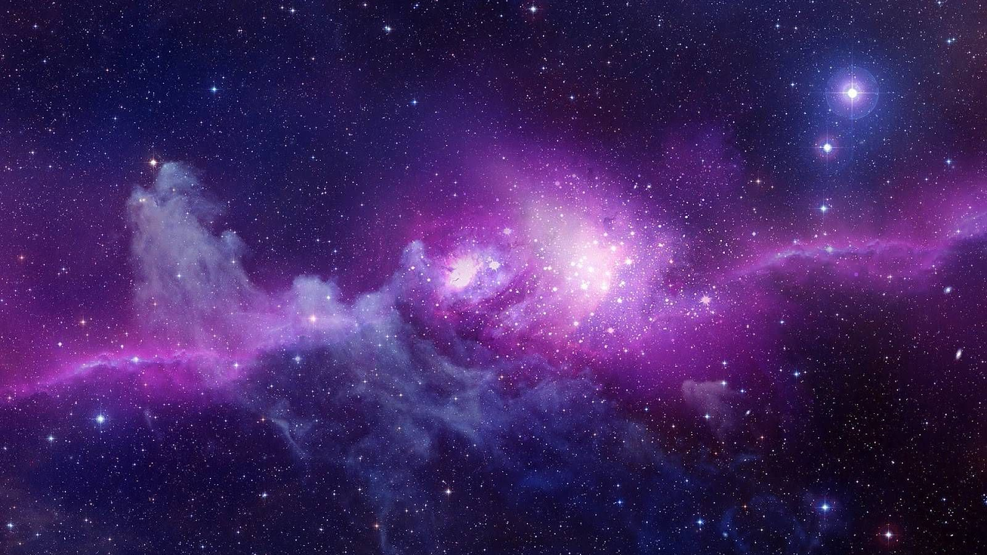
GalFIT with
Parallel Processing
Bailey Cross, Ammar Malik, Ben McColgan, Shah Hassan Syed

Slide 2
Special Thanks to:
Dr. Rose Finn
Physics Department
Kimberly Conger
PhD Candidate at KU
Dr. James Teresco
ITS for letting us use their server

Slide 3
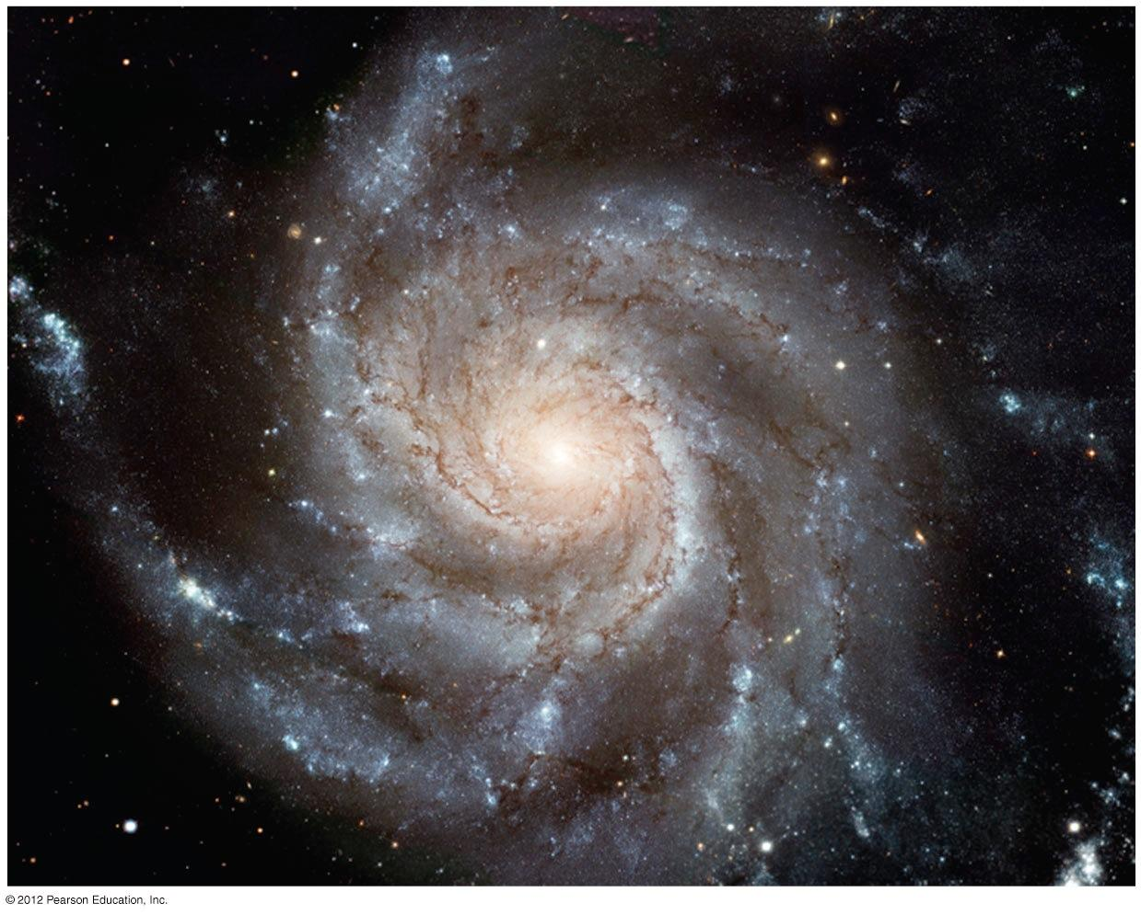
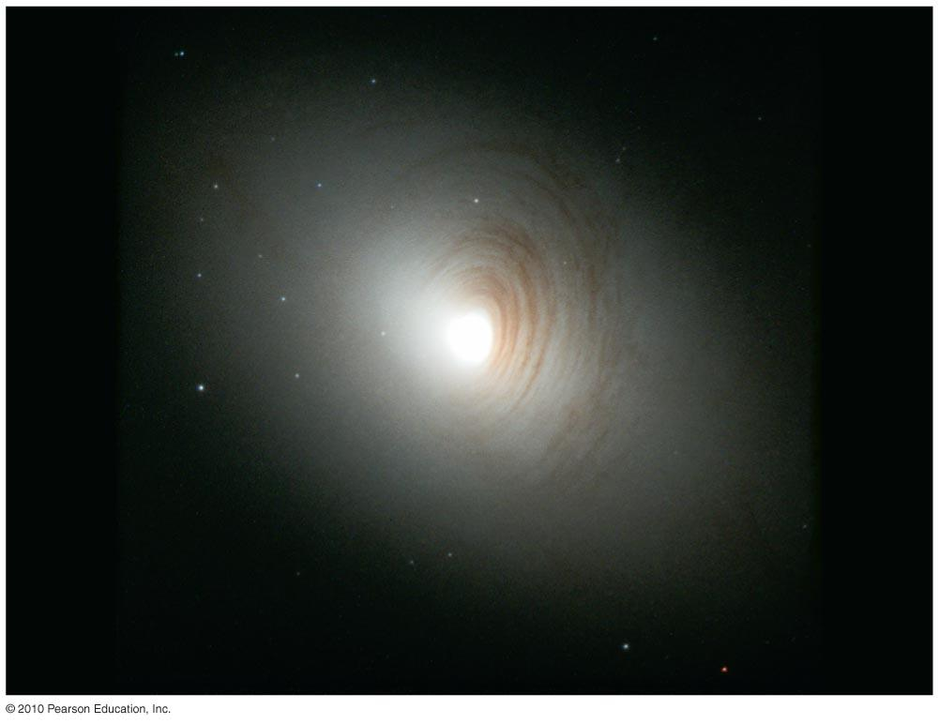
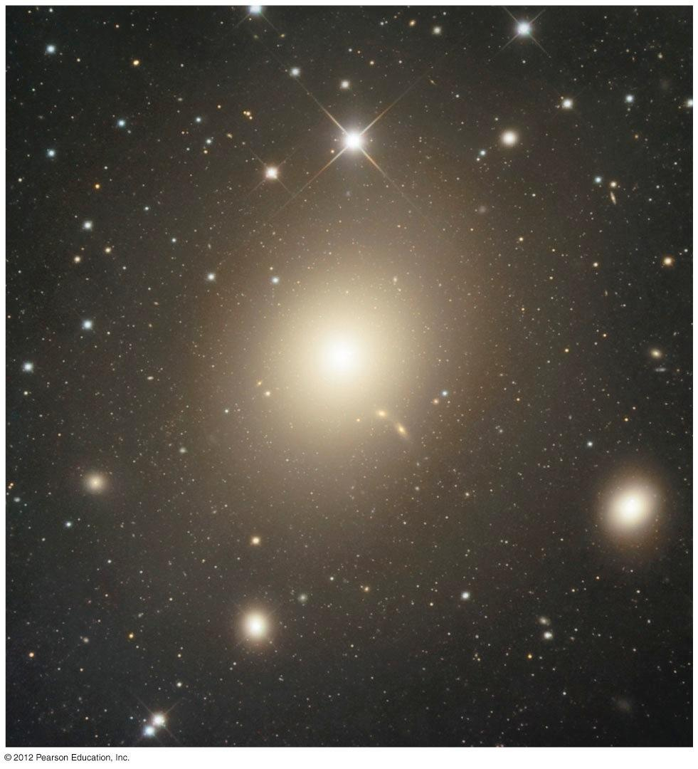
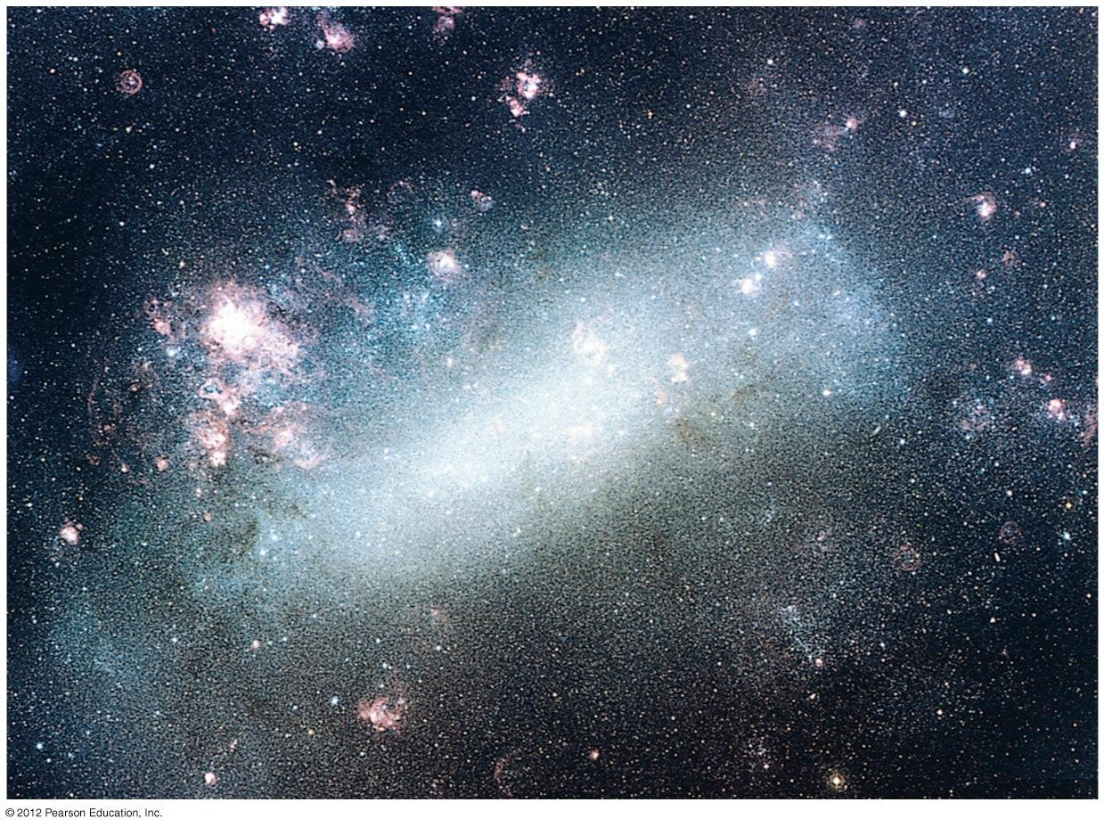
What is GalFIT?
GalFIT or Galaxy Fitting is an algorithm developed first in 2002 and published in a peer reviewed astronomical journal
The algorithm is based upon the light profile of different galaxies, and classifies them in accordance to that.
4 categories of Galaxies: Spiral Galaxies, Lenticular Galaxies, Elliptical Galaxies and Irregular Galaxies

Slide 4
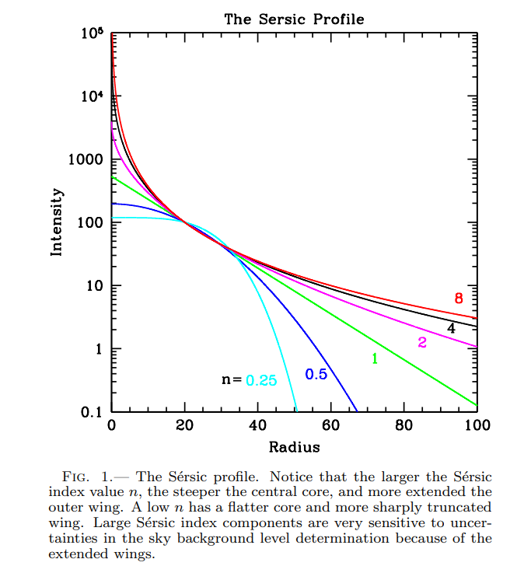
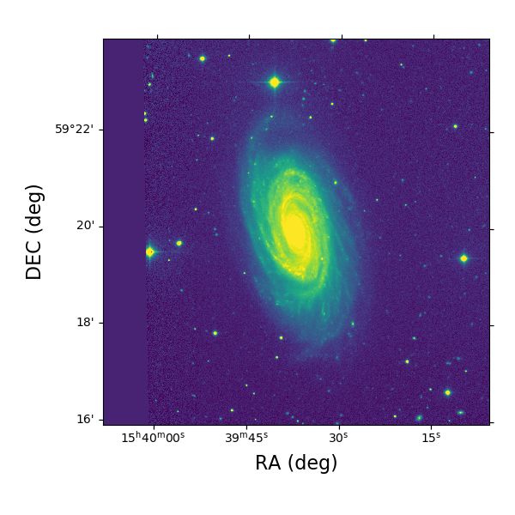
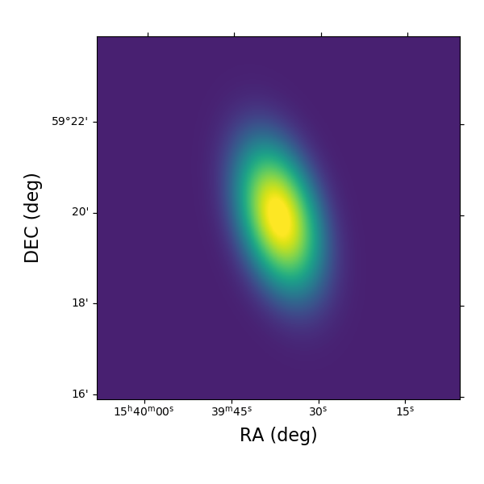
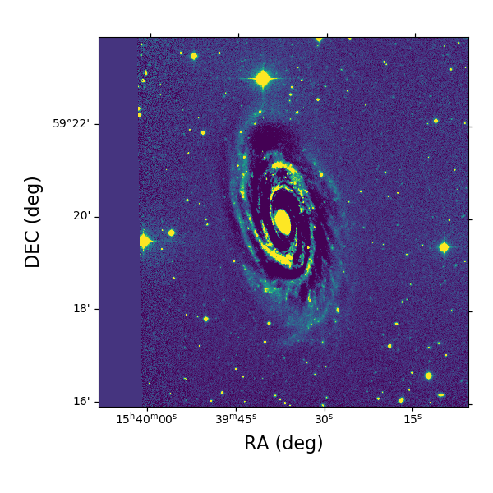
How does GalFIT work?
GalFIT uses Sersic Profile to classify
different types of galaxies.
Uses Levenberg-Marquadt Algorithm to
find local minimum of the galaxy model fit.
Input Image
Model
Residual

Slide 5
Running GalFIT
Input Parameters:
Input File (Includes further required arguments)
Image
Noise image
PSF (Point Spread Function)
Mask Image (to block out the objects that we don’t want to fit)
Input File:
n: concentration of the light profile (steepness) - what the light profile looks like vs radius
RE: radius that encloses half the light
B/A: Ratio of the semi minor axis to the semi major axis of the ellipse
PA: Position angle of the ellipse
(xc, yc): Center x and y coordinate
(magnitude): brightness in weird astronomy units (log scale rather than linear)

Slide 6
Initial Plans:
Plan 1:
Get to the source code
Introduce Pthreads to the algorithm
Divide the work on the threads using bag of tasks
Plan 2:
Introduce parallelism externally
Call the algorithm on different pthreads in a different program altogether

Slide 7

Faced with a roadblock
We don’t have access to the source code, and GALFIT won’t run on Noreaster. If we don’t have access to the source code, then we only have access to an executable file. What should we do and where can we run GALFIT?
When the journey looks like its about to come to an early end there is only one thing to do.

Slide 8
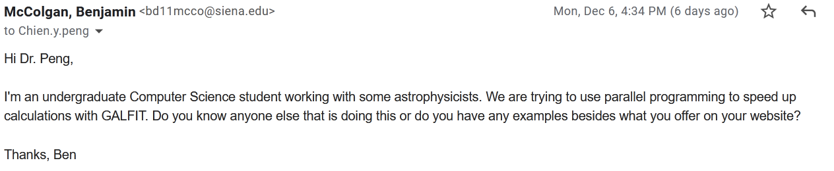
Email the creator of GALFIT (ask someone smarter than us)

Slide 9
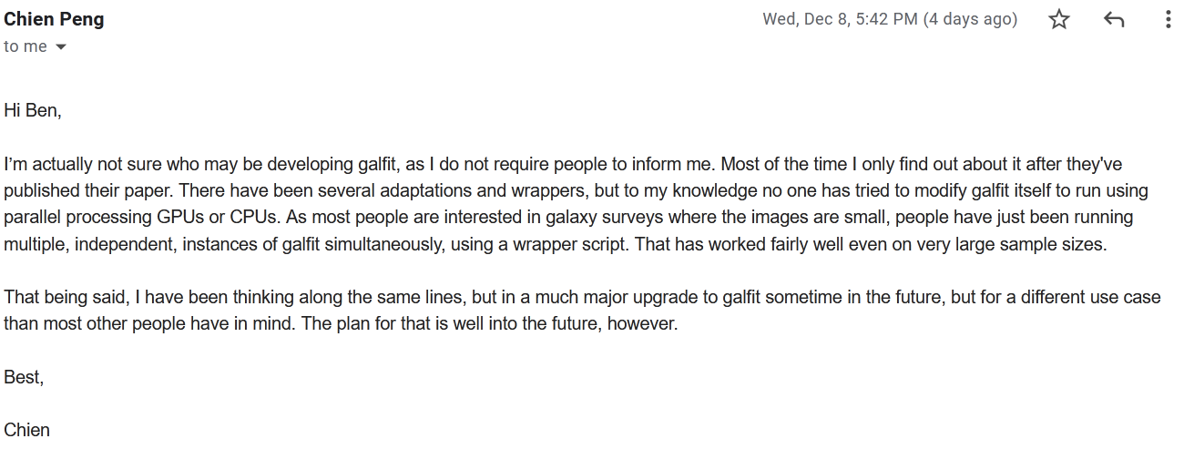
The creator of GALFIT replied!!!

Slide 10



Second Roadblock
GALFIT doesn’t run on FreeBSD so what do we do?
Luckily Dr. Teresco was nice enough to set us up on an ITS server using OpenNebula.
This allowed us to use a virtual debian server so that we can run GALFIT on our data.

Slide 11

GNU Parallel
What is GNU Parallel?
“GNU Parallel is a shell utility for executing jobs in parallel. It can parse multiple inputs, thereby running your script or command against sets of data at the same time.”

Slide 12
GNU Parallel Bash Script:
time parallel -j+0 --eta ‘cd {} && galfit galfit.feedme > output.dat && cat fit.log >> ../allFits.log’ ::: */
time records the time for the command to execute
-j+0 designates the jobs per core
--eta gives us system and core information
cd navigates to the galaxy subdirectories
galfit galfit.feedme runs galfit on a single galaxy in a subdirectory with the galfit.feedme input parameters
output.dat sends the process information from the screen to output.dat
cat fit.log >> ../allFits.log appends the output data for each galaxy to the file allFits.log file in the parent directory.

Slide 13
Results:
Running on 20 galaxies
Running on 900 galaxies
Iterative | GNU Parallel (20 Cores)
10.964s | 1.861s
Iterative | GNU Parallel (20 Cores)
12m 11.348s | 0m 40.673s
~18x speedup

Slide 14
Conclusion:
The skills we learned to complete this project:
How to use GALFIT.
Bash scripting.
Implementing GNU Parallel into bash scripts.
Overall, parallelizing this gathering of galactic data can help astronomers take big datasets of galaxies and output the information gathered into a collective file for future analysis.

Slide 15
Future Work
Currently we have only ran GALFIT on 900 galaxies but we plan on running GALFIT on Dr. Finn’s entire dataset which is over 14,000 galaxies.
Test galaxies using different types of fits and multiple fits at the same time.
In search of changing solutions we are going to parallelize the nested for loop to run galfit on one galaxy with different input parameters to see if the program gives different results.
This is to see if different starting points influence the result

Slide 16

Any Questions?

Slide 17
References
Dr.Finn and Kim Conger Presentation (https://docs.google.com/presentation/d/1A_bfAHTupukvotYuPRSJx8sUBumDzCrwn0P_m3C8rc0/edit#slide=id.g1039cda764e_0_141)
https://ui.adsabs.harvard.edu/abs/2002AJ....124..266P/abstract (GALFIT Paper)
https://users.obs.carnegiescience.edu/peng/work/galfit/README.pdf (GALFIT User manual)
https://www.gnu.org/software/parallel/parallel_tutorial.html (GNU Parallel Tutorial)

